Slide 1
Geochemical modeling of CH₄ & CO₂ in Arctic soil microcosms
Guoping Tang
April 18, 2016
EGU General Assembly
Notes:
Hello. Everyone. I am going to talk about using geochemical models to simulate soil carbon mineralization, and methanogenesis in soil microcosms.
The ultimate goal is to improve soil biogeochemical models in the land component for earth system models.
Even though we know that carbon mineralization and methanogenesis reactions are fundamentally redox reactions, most of the land models do not explicitly consider redox reactions
In addition, redox reactions change soil pH even though soil is often well buffered. A pH change of 1 log unit is often observed in the lab and in the field.
We know pH is an important environmental control of soil biogeochemical processes.
Therefore, we argue for using geochemical models mechanistically represent the biogeochemistry processes, with the hope to improve climate model predictability.

Slide 2
Outline
Introduction
Incubation tests
Model
Summary
Notes:
At first, I will give your some background.
Then I will talk about the incubation tests.
My focus will be how to use geochemical models to synthesize these observations.
Finally, I will end with a summary and next steps.

Slide 3


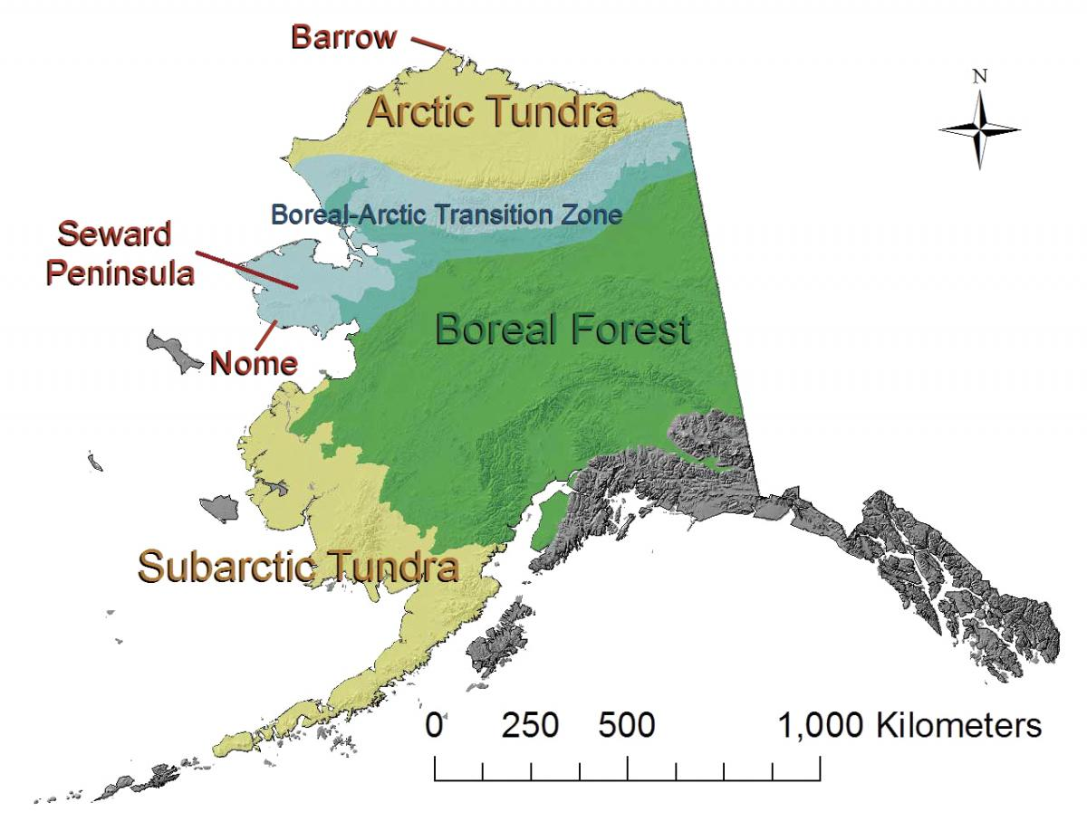
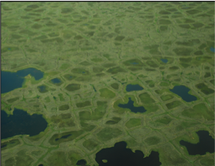
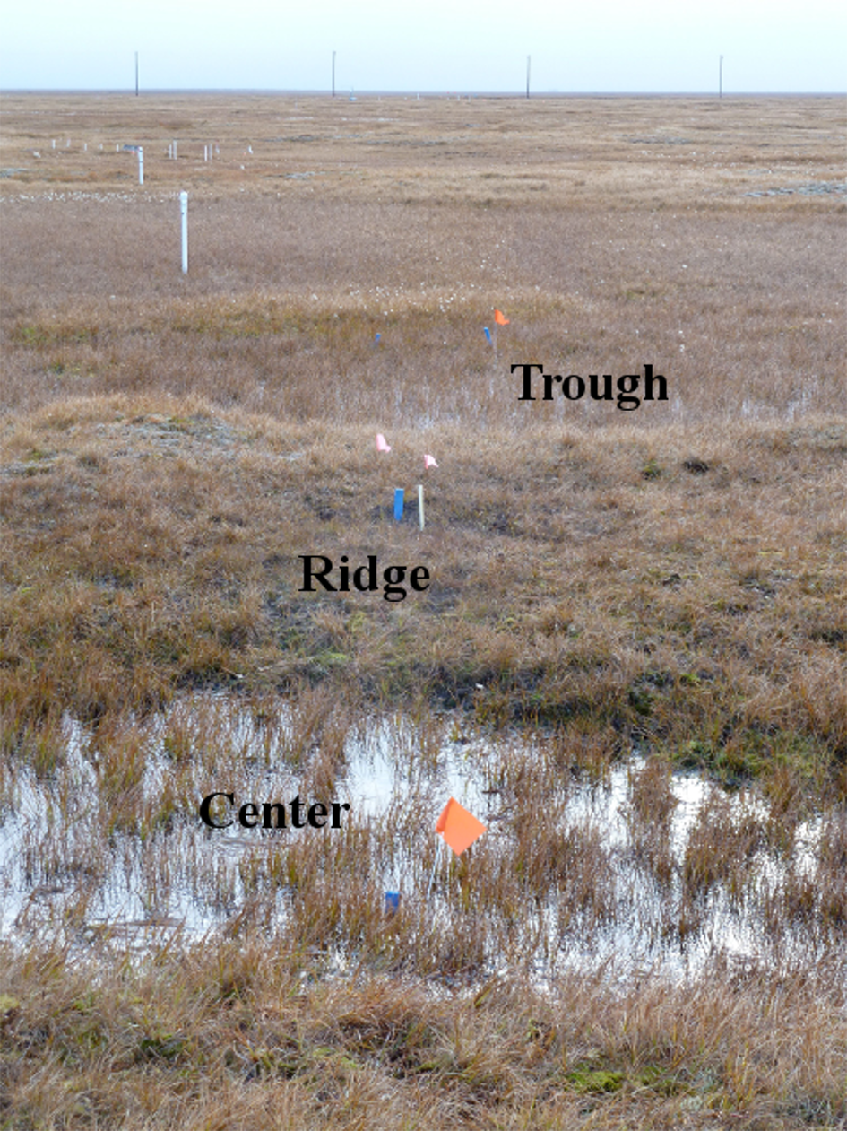
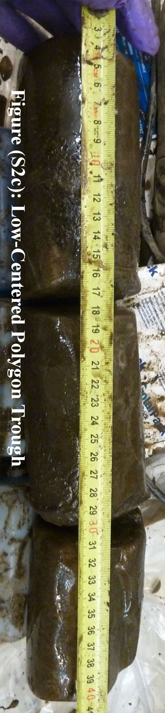
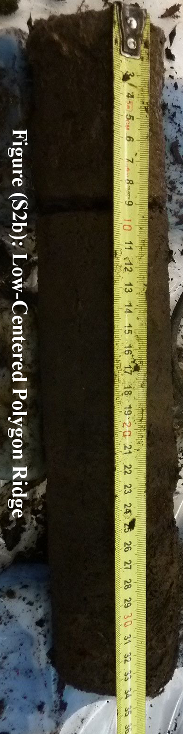
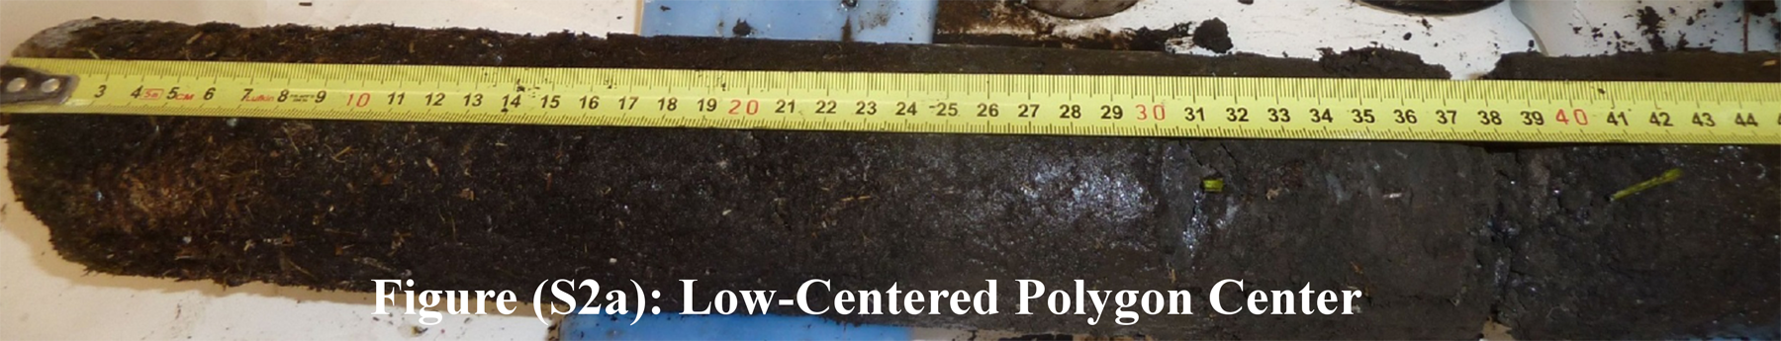
Introduction
Organic
Mineral
~50 cm
Trough
Ridge
Center
Low center polygon
Roy Chowdhury et al. 2015, Herndon et al. 2015
Notes:
This is part of the NGEE-Arctic project.
Some of you may know that it is a DOE funded project.
It involves four national laboratories and a university.
The mission is to improve climate predictions by understanding coupled processes in Arctic terrestrial ecosystems.
Today, I will talk about modeling of some incubation tests.
The experimental results were published last year. Here are the citation.
The site locates at the tip of the Alaska. It is characterized by drained thaw lakes, and polygonal grounds.
The soils were taken from a low center polygon.
We have three microtopographic locations: trough, ridge, and center.
We have two horizons: organic and mineral layer.

Slide 4
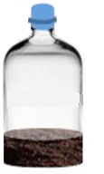
Incubation tests
15 or 20 g wet soil
60 ml sterile serum bottle
N₂
-2, 4, 8 °C
Headspace CO₂, CH₄
Soil pH, Fe(II), organic acids
Roy Chowdhury et al. 2015, Herndon et al. 2015
Notes:
15 g wet soils were incubated in 60 ml serum bottle.
The incubation temperature is -2, 4, and 8 degree to mimic the temperature in the site.
The incubation time is about 2 months to mimic the summer season
The carbon dioxide, methane concentrations in the headspace were measured periodically
To measure soil pH, Fe(II), and organic acids, more soil samples are needed.
20 g wet soils were used in separate bottles are incubated, and ph, Fe(II), and organic acids were analyzed only 3 to 4 times during the incubation.
The table summarizes the initial conditions:
Again, we have three topographic locations: trough, ridge, and center
We have two horizons: organic and mineral layers.
The pH ranges from 4.5 to 5.2, with organic layer slightly higher than mineral layers.
The soil dry weight in the organic layer is lower than the mineral layers, because of the low bulk density of organic layer.
Center organic layer has the lowest dry soil weight.
Organic layer has more weoc than mineral layer.
Organic layer has more totc than mineral layer as expected.
Center organic layer has the lowest TOTC because of low density.
But it has the highest WEOC and organic acid.
The results for Fe(III) is mixed.

Slide 5
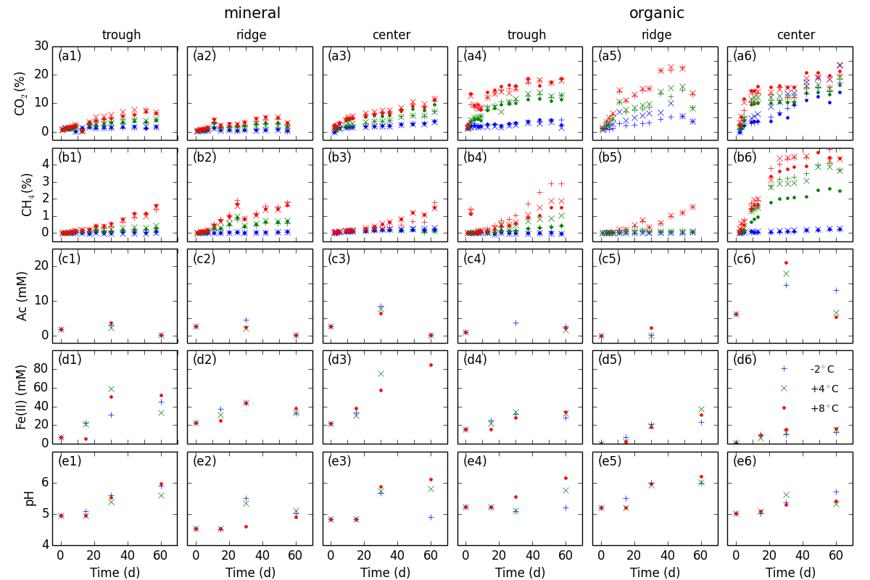
Experimental Results
Roy Chowdhury et al. 2015, Herndon et al. 2015
Notes:
Now let’s look at the incubation results:
I plot all of the observations here to gain a comprehensive understanding.
The hope is to build a general model that is applicable for all of the samples.
The left three columns are for the mineral layers in the trough, ridge and center locations.
The right three columns are for the organic layers in the three locations.
I plotted them this way as the observations appear to separate between the organic and mineral layers, more than among trough, ridge, and center locations.
The first two rows are head space carbon dioxide and methane concentration.
The bottom three rows are organic acids, Fe(II), and pH in the soils.
The color, blue, green and red represent 8, 4, and -2 degree Celsius.
Overall, in the headspace, CO2 increases in a con’vex curve, in contrast, CH4 increases in a con’cave curve.
The CO2 and CH4 accumulate more in the organic layer than in the mineral layer. Which is expected as the organic layer has more organic carbon.
CO2 concentration stabilizes after the early sharp increase.
CH4 continuously increase, except center organic layer.
Organic acids increase and then decrease, to very low concentration in the mineral layer. With some leftover in the organic layer.
The Fe(II) and pH trends are similar, increase and then stabilize.
pH increased to about 1 log unit.
While the CO2 and CH4 concentration appears to correlate positively with increasing temperatures, the correlation for the the organic acids, Fe(II), and pH with temperatures are mixed.
Now we would like to use these observation to develop a model.
We use Monod growth function and parameters from the literature for Fe reduction and methanogenesis
We partition the initial TOTC among SOM1, SOM2, SOM3, and SOM4 pools.

Slide 6
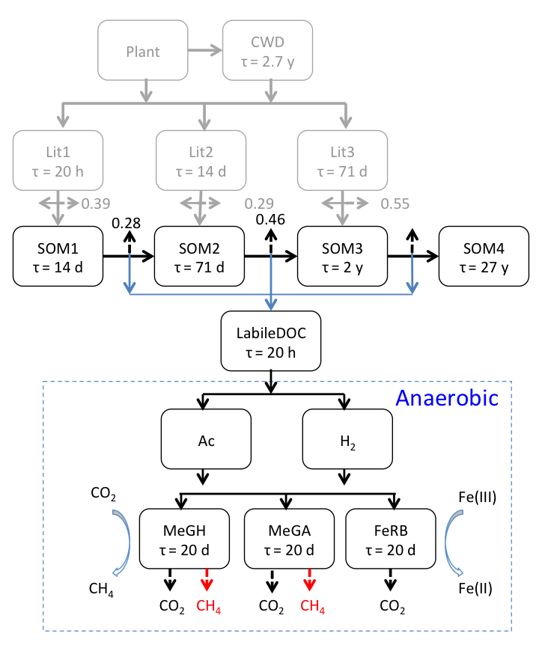
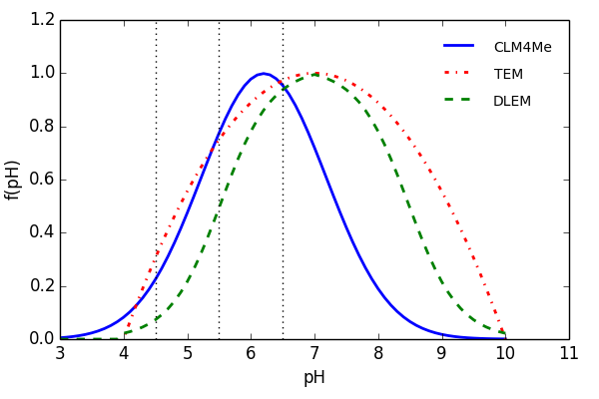
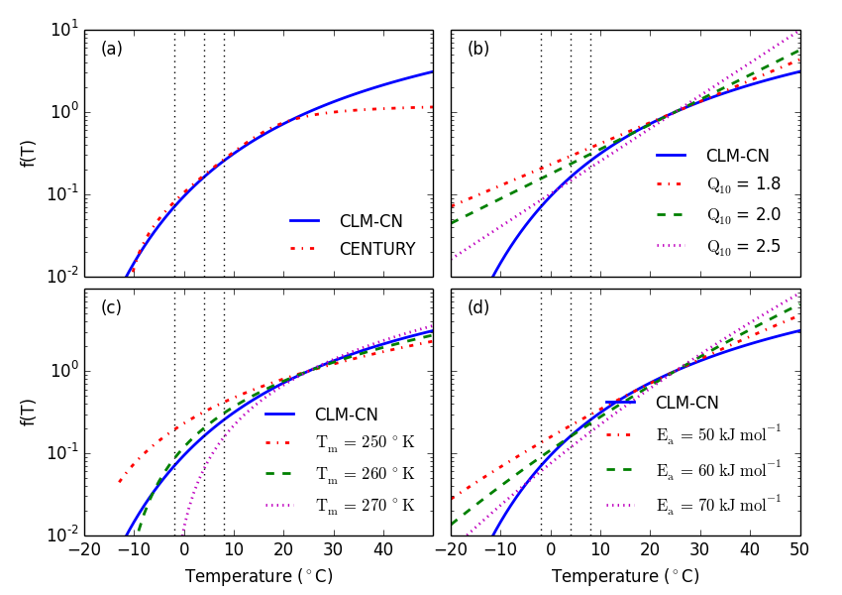
Model Development
Ratkowsky
Arrhenius
Humic Ion-Bing Model V (Tipping 1994)
PHREEQC (Parkhurst and Appello 2013)
Notes:
The underlying processes are soil organic carbon decomposition, methanogenesis, and Fe reduction.
Many soil organic carbon decompositions were developed.
To described CO2 with limited enzymetic and microbial data, most models use first order decay models, with fast and slow pools.
Because our objective is to improve CLM, we start with CLM-CN decomposition cascade.
To add methanogenesis and Fe reduction, we need an organic acids pool to provide substrates for fe reducers and methanogens.
For this, we split the original respiration into direct respiration and indirect respiration
We assume that the indirection respiration go through fermentation to produce organic acids and H2, and then respire as CO2 or CH4
Therefore, we added the LabileDOC pool, Ac, H2, and acetoclastic and hydrogentrophic methanogens, and fe reducers.
Microbes normally growth the best at about neutral pH.
To describe pH response, we consider the response functions in CLM4Me, TEM, and DLEM. Overall, the rate is quite sensitive to pH.
To describe the temperature impact, we consider a number of response functions.
For our temperatures, CLM-CN and CENTURY are very close.
CLM-CN is close to the Q10 method with Q10 -2.5,
Arrhenius equation for Ea = 60 kJ mol-1,
and the Ratkowsky for Tm = 260 degree kelvin
We use the Humic Ion-Binding Model V to describe the pH buffering due to soil organic matter.
We use PHREEQC as the simulation tool.
To use the model to describe the incubation tests, the measured initial pH, Fe(II), organic acids, etc., can be used as initial conditions.
We can use the totC for the Humic Ion-Binding Model V.
We need to split the measured TOTC among the organic carbon pools.
To limit the number of parameters, we lump the Lit1 with LabileDOC, Lit2 with SOM1, and Lit3 with SOM3 as they have the same turnover time.
Literature data usually suggests only a small percentage of the TOTC in the fast decomposition pools.
The short duration experiments observations are sensitive only to the fast pools.

Slide 7
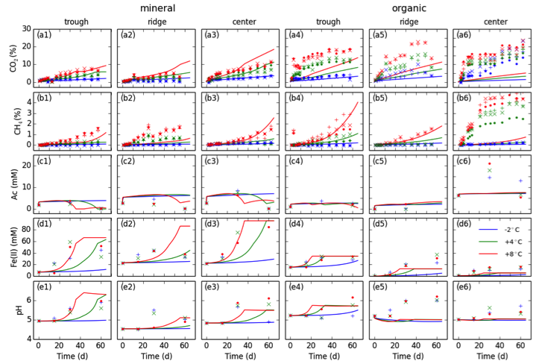
Modeling results (1)
LabileDOC = 0.001, SOM1 = 0.01, SOM2 = 0.02, Biomass = 10⁻⁶ TOTC
Fe(III) = 0.005 Soil dry weight, indirect respiration fraction = 0.4
Notes:
Therefore, we parameterize LabileDOC as 0.001, SOM1 = 0.01, and SOm2 = 0.02 of the TOTC
Microbial biomass for methanogens and Fe reducers as 1e-6 TOTC, about similar magnitude as the cell counts.
Fe(III) as 0.005 of the initial soil dry weight.
With these parameterizations, here are the predictions, in comparison with the observations.
Note that we use identical model parameters, different experimental parameters (e.g., TOTC, water, soil dry weight, etc.)
The model predicts convex curve for CO2, concave curve for CH4, increase and decrease of organic acids, increase and stabilizes for Fe(II) and pH.
The predictions are closer to the observations for the mineral layers than for the organic layers.
The model underpredicts the CO2 in the organic layers. This is probably because organic layer, more of the totc are labile. Increase the initial pool fraction increase prediction CO2 prediction.
The model also underpredicts Fe(II) and pH increase, in particular, for the center organic soils.
This is because we have the least amount of dry weight, therefore, Fe(III).
If we increase the fraction of initial Fe(III), this can be improved.

Slide 8
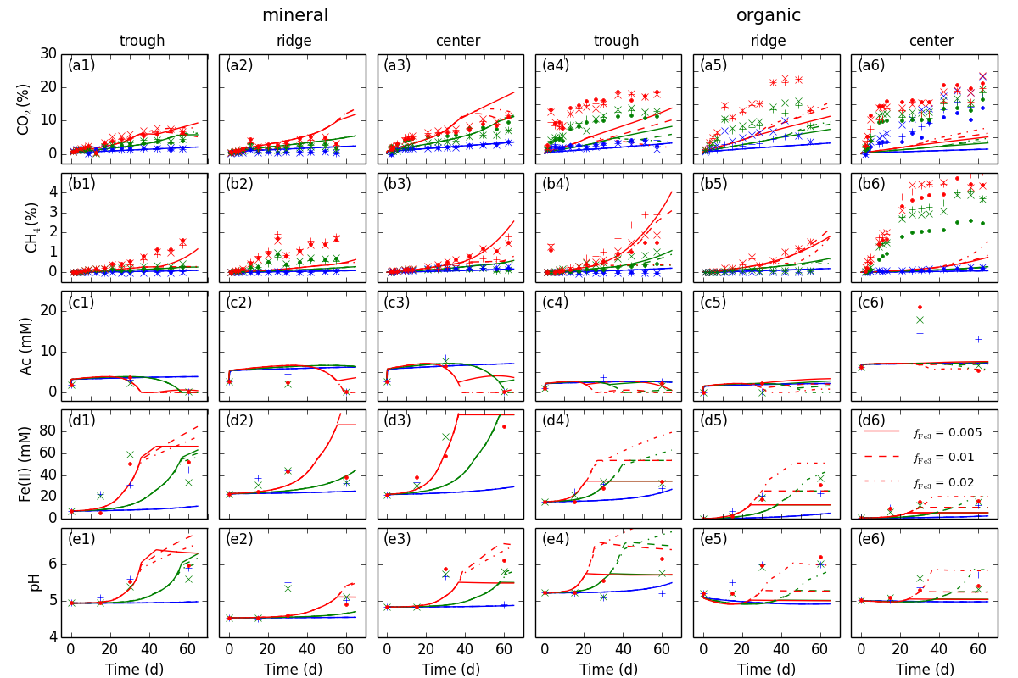
Modeling results (2, Fe³⁺ sensitivity)
Notes:
Fe(III) reduction is generally reported to inhibit methanogenesis due to substrate competition.
Which is the case In the mineral soils where organic acid limits methanogenesis
For the ridge and center organic soils, Fe reduction actually increase methanogenesis because Fe reduction increase the pH, which is favorable for methanogens while the organic acids are not limiting.
Therefore, Fe reduction can inhibit methanogenesis by substrate competition, while promote methanogenesis by raising pH.
Fe reduction increase CO2 concentration in organic ridge, and center soils, and mienral ridge soils, it decrease headspace CO2 concentrations in the rest at the later times.
This is because of increased solubility of CO2 at increased pH.

Slide 9
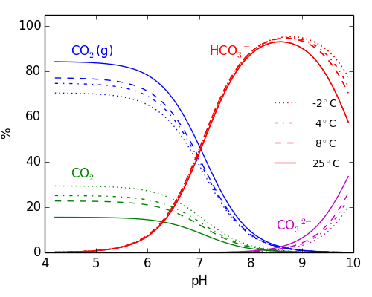
Modeling Results (3, CO₂ partition)
Notes:
Here we conduct calculations with our typical microcosms to see the distribution of CO2.
At low pH, CO2 are mostly in the headspace. The dominance decreases with increasing pH.
The dominance of CO2 gas phase also decreases with decreasing temperature.
In addition, there are substantial amount of CO2 adsorbed in the metal oxides surfaces.
Adding CO2 adsorption introduces an another CO2 into the model microcosms.
Which may contribute to CO2 in the headspace when pH changes, metal oxides reduced and dissolved.
The point is, if we use headspace concentration to estimate respiration, we could underestimate the respiration without adequately accounting for the distribution among adsorbed and dissolved phases.

Slide 10
Take home message
Geochemical models describe pH evolution in soil incubation tests
Fe reduction inhibits methanogenesis through substrate competition and increases methanogenesis rate by increasing pH.
CO₂ distribution among aqueous, gas, and adsorbed phase varies with pH, temperature, therefore, estimation of CO₂ emission based on headspace concentration needs to adequately account for these conditions.

Slide 11
Next Steps
Synthesize new data for other topographic units
Extend the model to differentiate sugars, alcohols, and organic acids
Test geochemical models in CLM-PFLOTRAN (See poster in Thursday evening)

